Slide 1
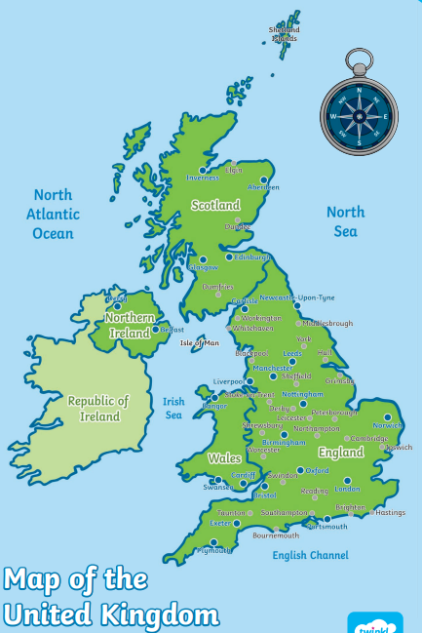
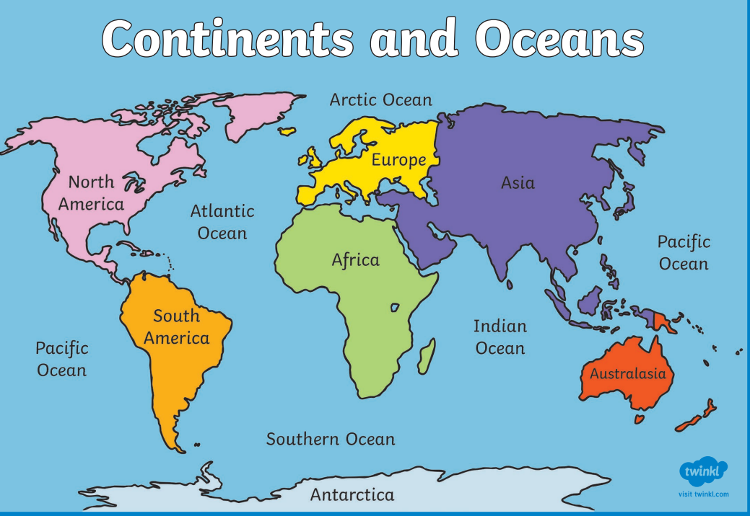
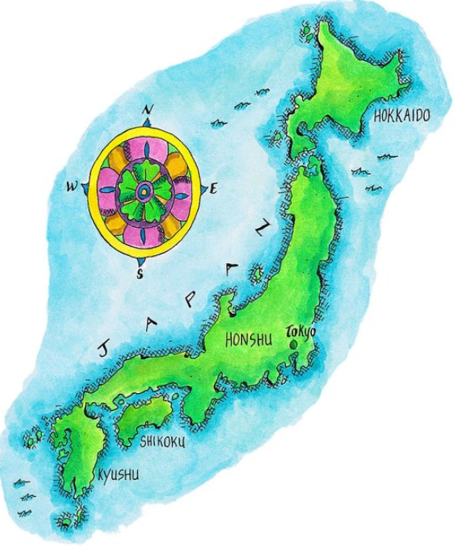
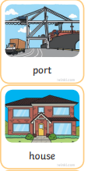
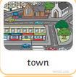
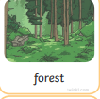
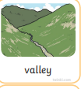
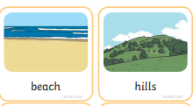
KNOWLEDGE ORGANISER
How are schools the same?
VOCABULARY
Physical features | The natural things in the Earth’s surface.
Human features | Things made or built by humans.
continent | A continuous expanse of each of the world’s lands
United kingdom | Made up of England, Northern Ireland, Scotland and Wales.
globe | A spherical or rounded object representing the earth.
atlas | A book or collection of maps.
contrast | Something that is strikingly different from something else.
line | A long narrow mark or band.
Human Features
Physical Features
What should I know by the end of the unit?
I understand geographical similarities and differences between the United Kingdom and Japan. We use basic geographical vocabulary to referring to: key physical features, including: beach, cliff, coast, forest, hill, mountain, sea, ocean, river, soil, valley, vegetation, season and weather We use key human features, including: city, town, village, factory, farm, house, office, port, harbour and shop. We can identify the UK and its countries. We can identify the continents of the world using atlas and globes.
compare | The similarities or difference between things

Slide 2
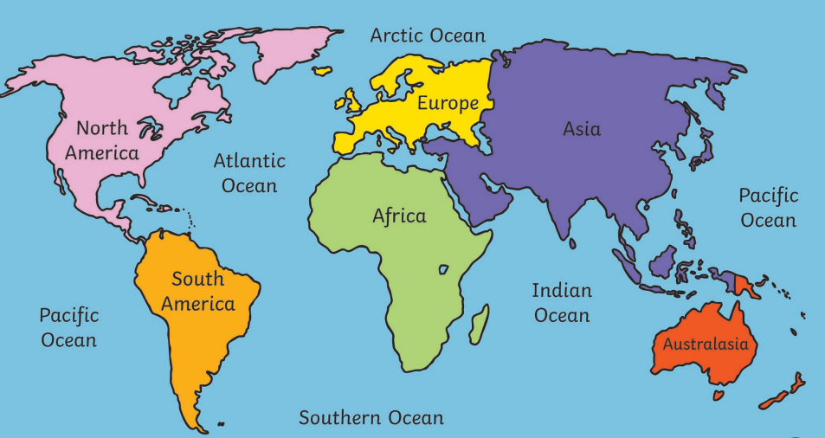
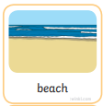
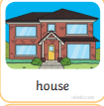
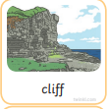
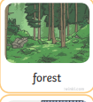
Assessment
Question 1: Which continent is the biggest?
Question 2: Which continent is Japan in?
Quest on 4: Circle the United kingdom and Japan on the world map.
Question 3: Tick the features that are physical.
Question 5: What does the word contrast mean?

