Slide 1
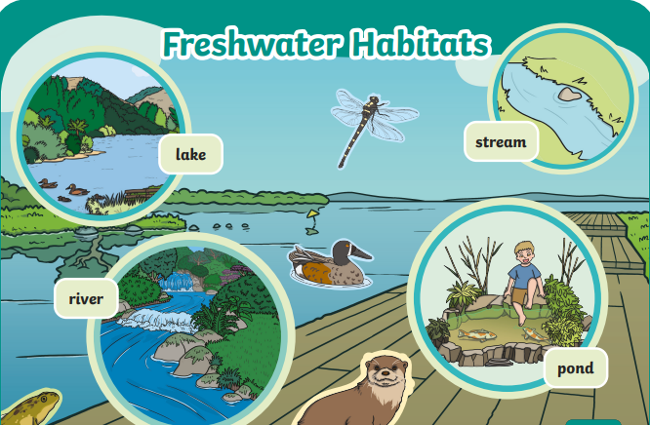
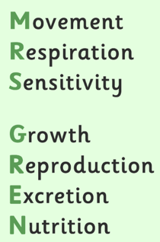
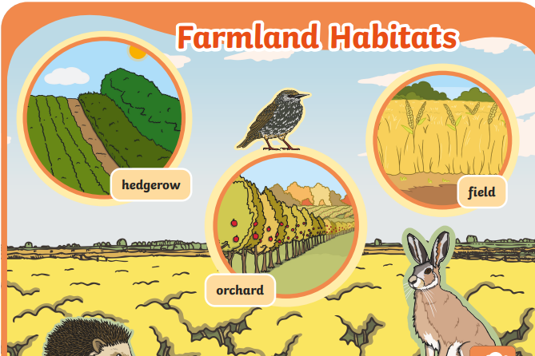
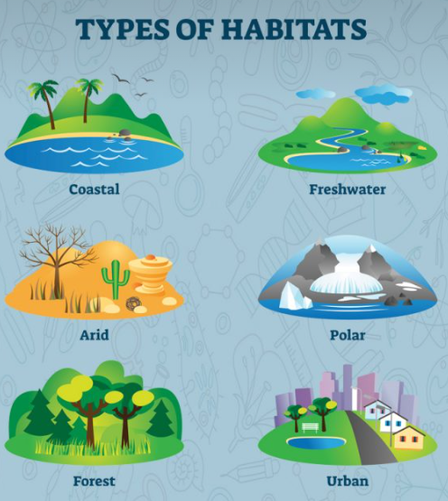
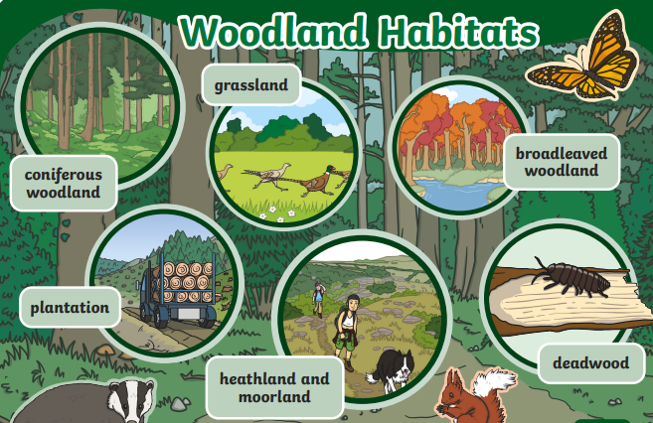
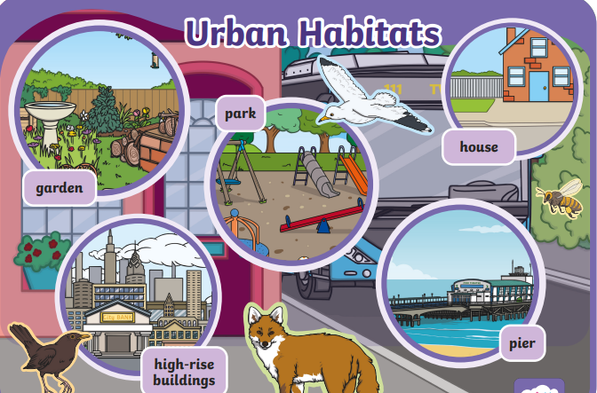
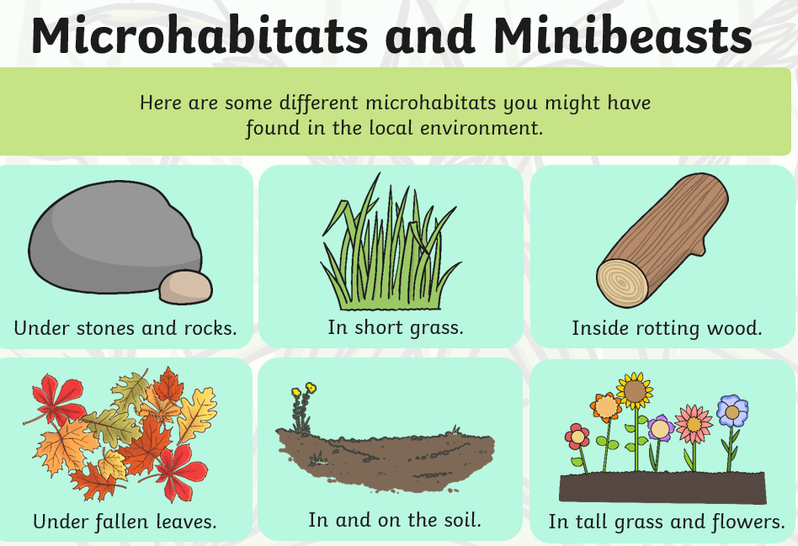
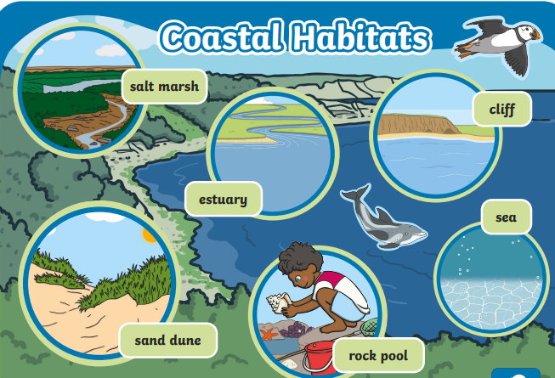
What is home?
KNOWLEDGE ORGANISER
VOCABULARY
Non-living | Not having any life; breathing, growing, moving, etc.
habitat | Natural home
macro habitat | A large area with a variety of plants and animals e.g. desert or rainforest
nutrients | Substance that provides nourishment that keeps the plant or animal alive.
dependency | When one animal relies on a plant or other animal to keep it alive.
adapted | Being able to survive in the climate and conditions of the habitat.
Evidence | Information indicating or showing something.
What should I know by the end of the unit?
Explore and compare the differences between things that are living, dead and things that have never been alive Identify that most living things live in habitats to which they are suited and describe how different habitats provide for the basic needs of different kinds of animals and plants, and how they depend on each other; Identify and name a variety of plants and animals in their habitats, including micro-habitats. Notice that animals, including humans, have offspring which grow into adults
Food chains
Producer consumer/prey predator/ prey apex predator

Slide 2
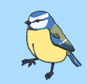
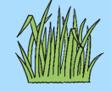
Assessment
Question 1: Circle the non-living pictures.
Question 3: How is a polar bear adapted to its habitat in the arctic?
____________________________________________________________________________
Question 4: Which animals might we find in our local woods?
Question 5: Put these living things in order to make a food chain.
Question 2: Name and draw 2 macro habitats.
1. ________________ 2._________________

