Slide 1
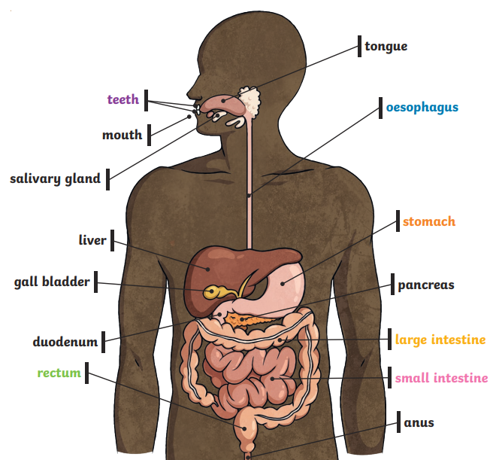
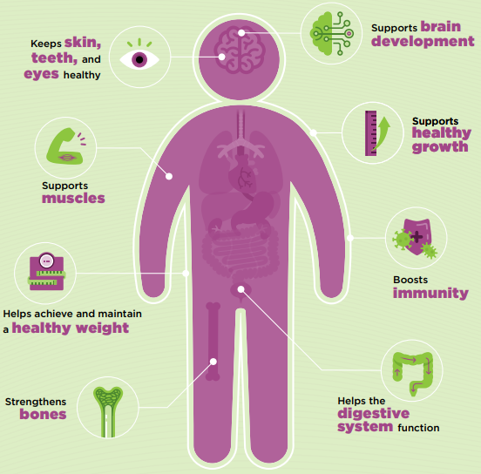
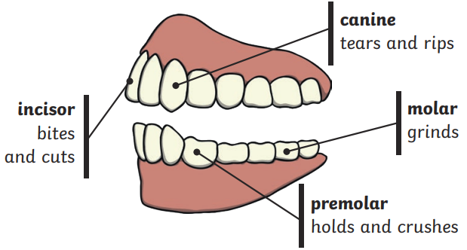
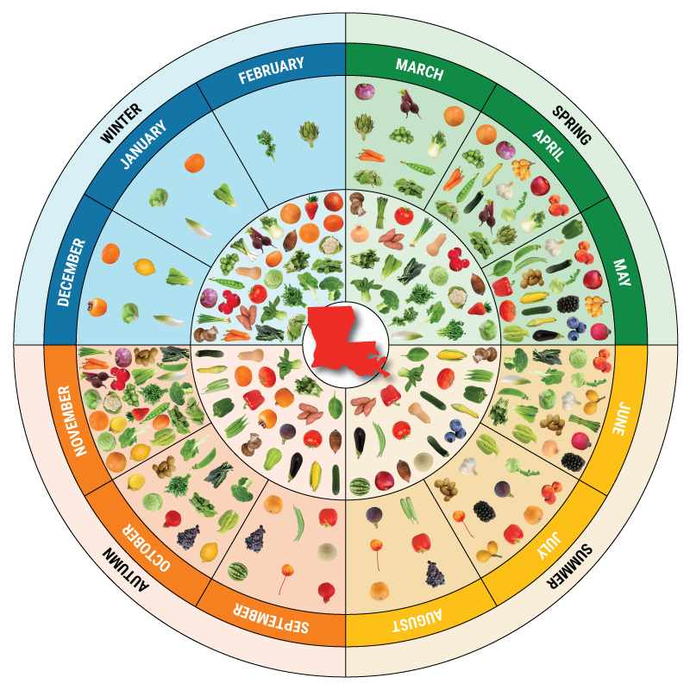
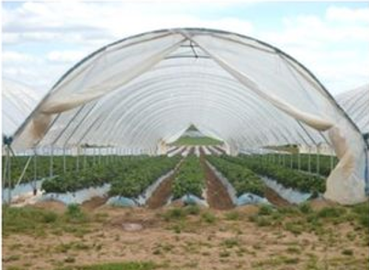
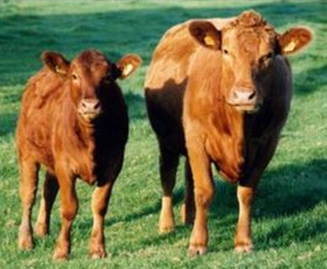
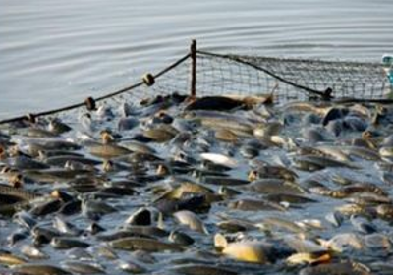
Why are food choices we make important?
KNOWLEDGE
ORGANISER
ESSENTIAL VOCABULARY
digest | Break down food so it can be used by the body
incisors | Teeth used for biting and cutting food
canines | Teeth used for tearing and ripping food
molars | Teeth used for grinding food
food chain | The outline of who eats whom
producer | An organism such as a plant that makes its own food
consumer | An animals that eats another plant or animal
predator | An animal that hunts and eats other animals
prey | An animal that gets hunted and eaten by another animals
herbivore | An animal that eats plants
carnivore | An animal that eats other animals (meat)
omnivore | An animal that eats plants and animals
balanced diet | A diet consisting of a variety of different food types and groups
seasonality | The time of year where a particular food is ready to be harvested
vegetarian | A person who chooses to not eat meat and fish
vegan | A person who chooses to not to eat anything that comes from an animal
The Digestive System
Principles of a healthy and varied diet
Human teeth and their functions
Seasonality
How foods are produced
Grown
Reared
Caught
An example of a food chain

Slide 2
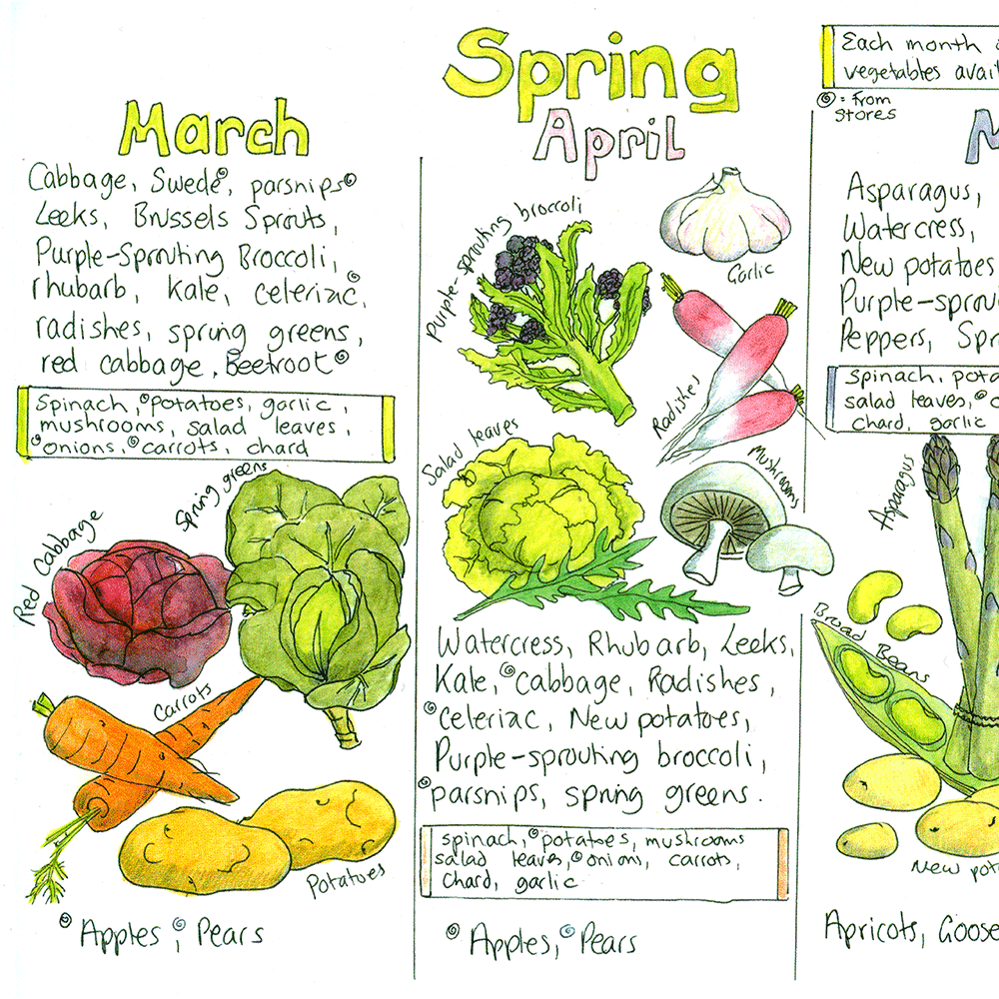
1. Number the steps of the digestive system
Small intestine Esophagus Large intestine Stomach Mouth
4. Draw a simple food chain you might find in a forest
2. Draw and label one type of tooth with it’s function
5. Name 2 vegetables that are seasonal in April and explain what seasonal means
Quiz!
3. Explain the meaning of each word
Grown_____________________________ Caught ______________________________ Reared_______________________________ Processed ____________________________
Seasonality means _____________________________________________________________________________________________________

