Slide 1
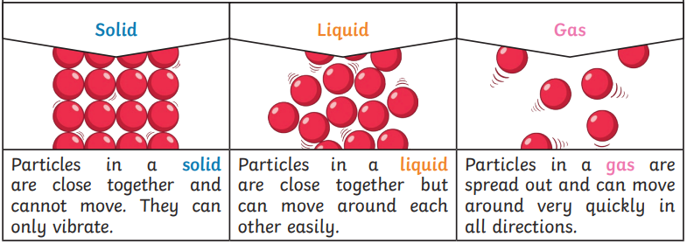
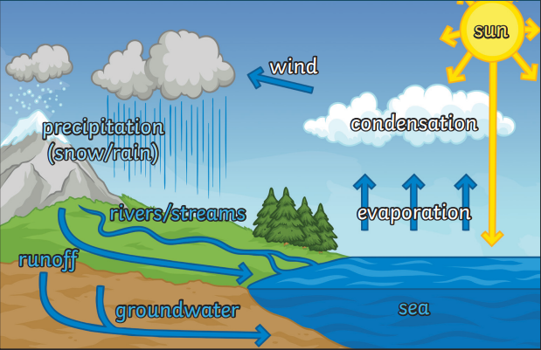
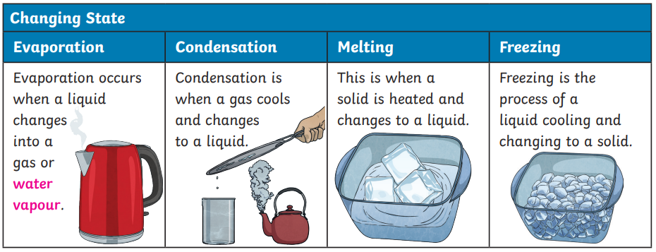
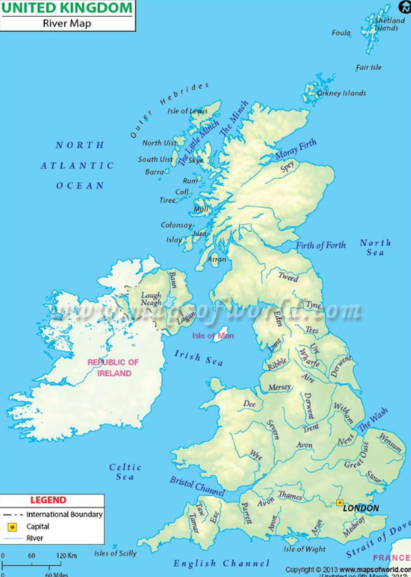
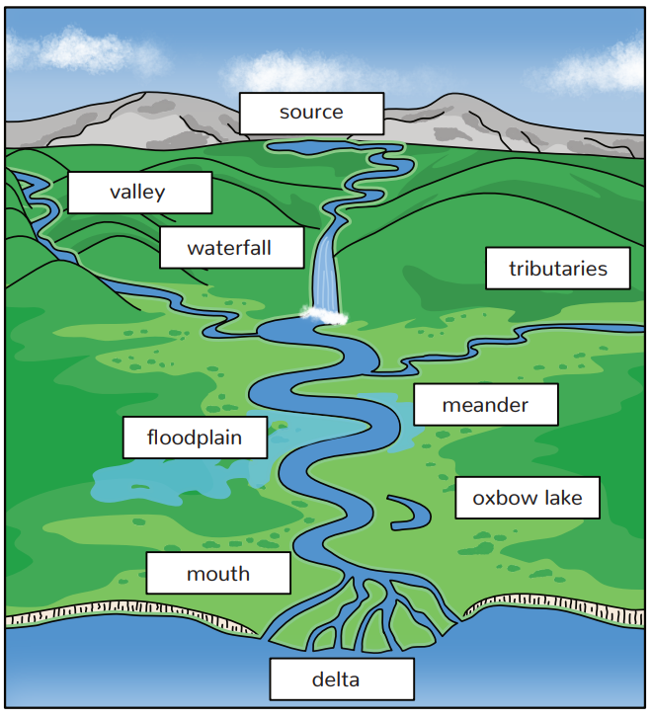
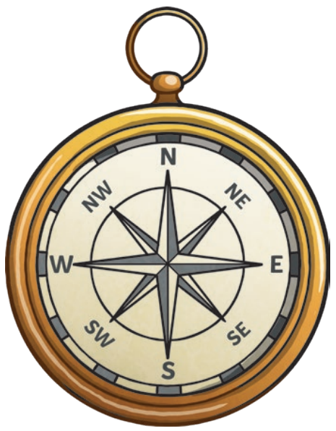
Where does our water come from and what are the effects of water pollution?
ESSENTIAL VOCABULARY
States of matter | Materials can be one of three states (solid, liquid, gas). Some materials can change from one state to another and back again.
solid | Materials that keep their shape unless force is applied. They can be hard or soft.
liquid | Liquids take the shape of their container. They can flow or be poured.
gas | Gases spread out and fill the space they are in. They do not have a fixed shape.
melting | When a solid is heated and changes to a liquid.
freezing | When a liquid is cooled and changes to a solid.
evaporation | When a liquid changes into a gas or water vapour.
condensation | When a gas is cooled and changes into a liquid.
Water vapour | Water that is in the form of a gas.
Water cycle | the continuous movement of water as it flows and moves around the Earth and atmosphere in different states
precipitation | Liquid or solid particles that fall from the clouds (rain, sleet, snow, hail).
source | The place where a river begins.
mouth | The point where a river joins the sea.
tributaries | Rivers that join up with another river.
Compass | A device used to show direction.
Solids, liquids, gases and changing state
KNOWLEDGE ORGANISER
The Water Cycle
Rivers in the UK
The journey of a river

Slide 2
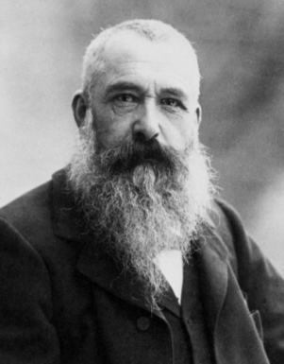
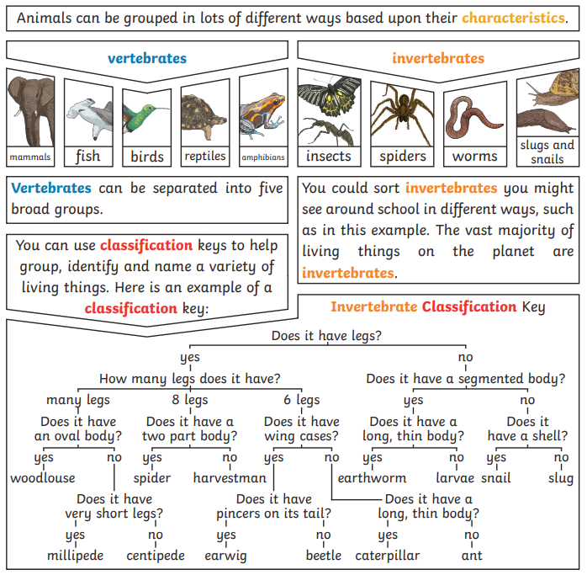
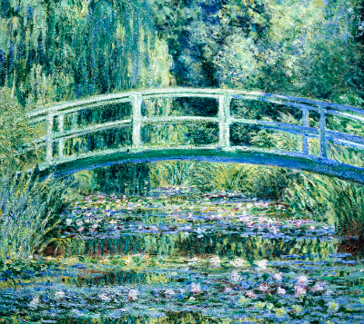
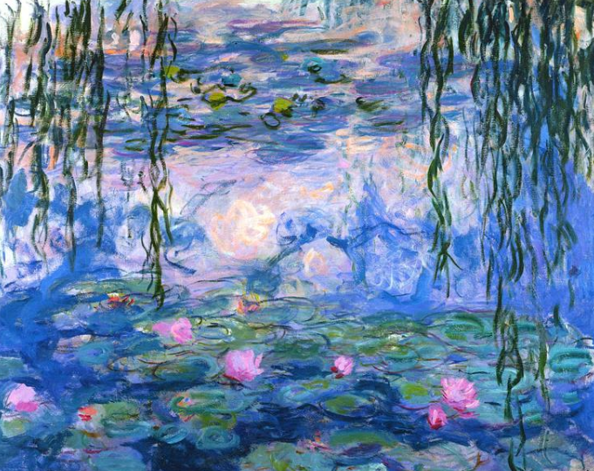
Where does our water come from and what are the effects of water pollution?
ESSENTIAL VOCABULARY
Life Processes | The things living things do to stay alive.
organisms | Another word used for ‘living things’.
respiration | A process where plants and animals use oxygen gas from the air to help turn their food into energy.
sensitivity | The way living things react to changes in their environment.
reproduction | The process in which young are produced.
excretion | The process by which living things get rid of waste products.
nutrition | The process of obtaining food to provide living things with energy to live and stay healthy
pollution | Where harmful materials or substances have made it into an environment.
environment | A place that is home to both living and non-living things. They contain many habitats.
Classification | This is where plants or animals are placed into groups according to their similarities.
vertebrates | Animals with a backbone.
Invertebrates | Animals without a backbone.
characteristics | The distinguishing features or qualities that are specific to a species of plant or animal.
Tone | In painting, tone refers to the relative lightness or darkness of a colour. One colour can have an almost infinite number of different tones.
Warm and cool colours | Warm colours evoke a range of feelings from warmth and joy to anger and hostility. Cool colours evoke feelings of calmness and serenity, as well as sadness.
KNOWLEDGE ORGANISER
Claude Monet (1840 – 1926)
Life Processes
To stay alive and healthy, all living things need certain conditions to allow them to carry out the seven life processes. We can use MRS GREN to remember them. M – movement R – respiration S – sensitivity G – growth R – reproduction E – excretion N - nutrition
Oscar-Claude Monet was a French painter. He was the founder of impressionism painting which is where short brush strokes are used to add layers of paint.
How can animals be grouped?
Waterlilies and Japanese Bridge -1899
Water Lilies - 1910
Effects of changes to habitats and environments

Slide 3
Assessment
___________________________________________________________________________________________________________________________________________________________________________________________________________________________________________________________________
______________________________________________________________________________________________________________________________________________________________________________________________________________________________________________________________________________________________________________________________________________________________________________
__________________________________ __________________________________ __________________________________
________________________________________ ________________________________________________________________________________________________________________________
______________________________________________________________________________________________________________________________________________________

